Slide 1
Canine Health & Welfare
NZDJA Conference 2019

Slide 2
Current Situation

Slide 3
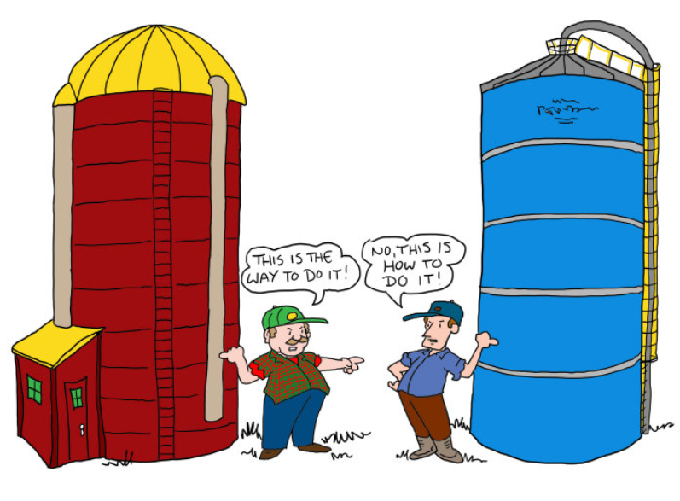
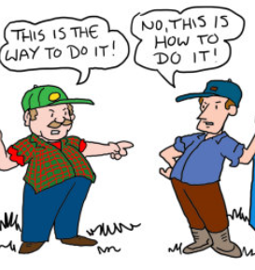
The Reality
Dogs NZ
CH&W
BSC
NZDJA

Slide 4
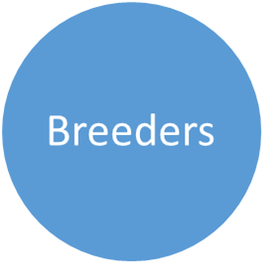
The Ideal
Dogs NZ

Slide 5
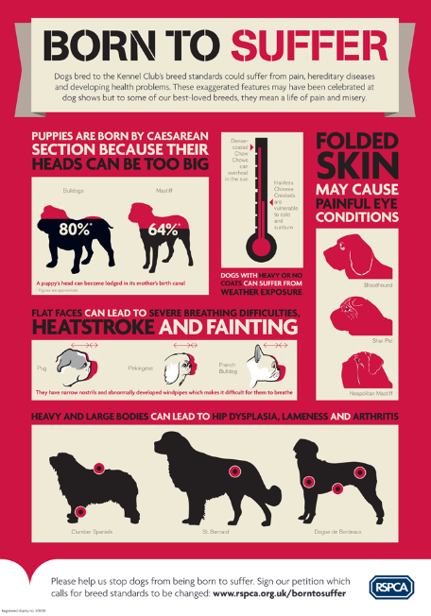
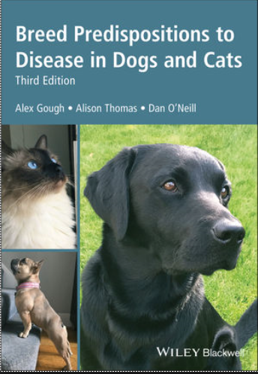
Animal Welfare

Slide 6
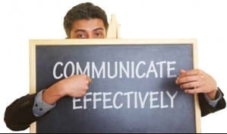
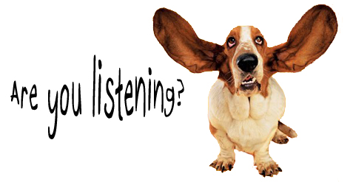
What this means to Dogs NZ

Slide 7
What this means to Judges ?
Gradings
Critiques
Judges’ Reports

Slide 8
Comments and feedback
Who should drive this?
What training is required for Judges?
How quickly is this achievable?
What has to change to allow this to happen?

